Slide 1
Why polymer theory is beautiful (and why you should care)
Takashi Yokokura
CBE Student Colloquium
04/27/2023

Slide 2
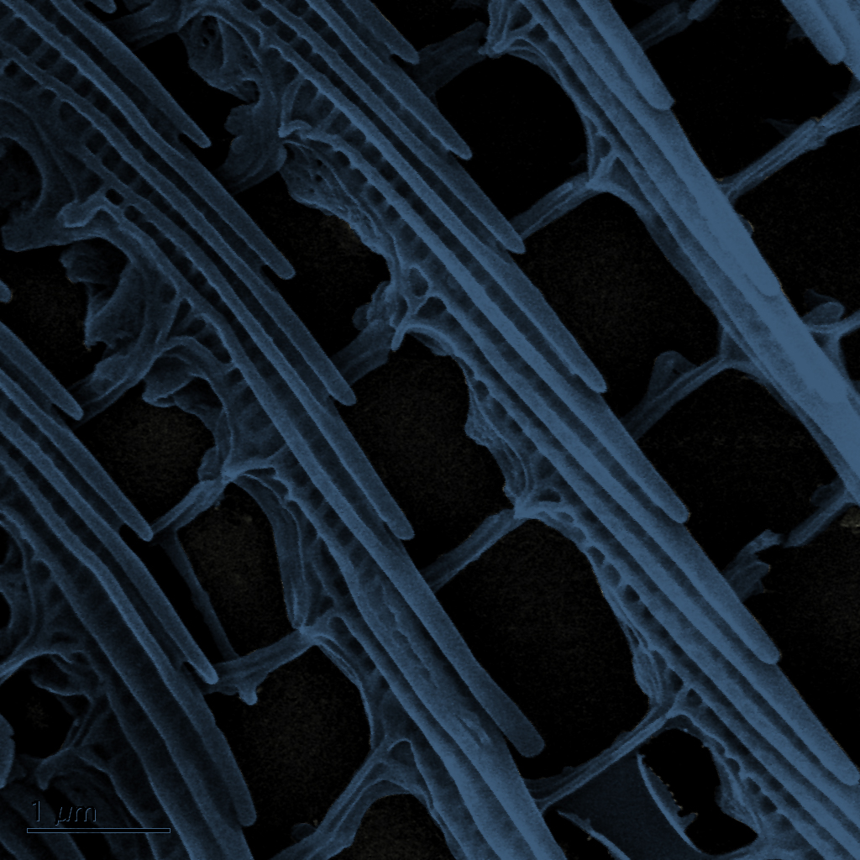
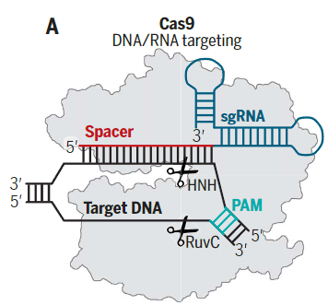
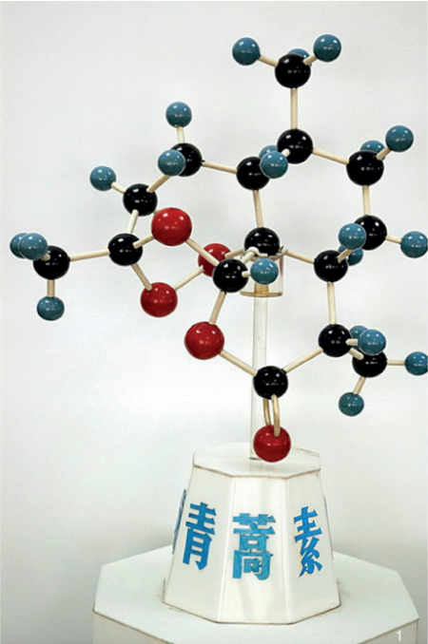
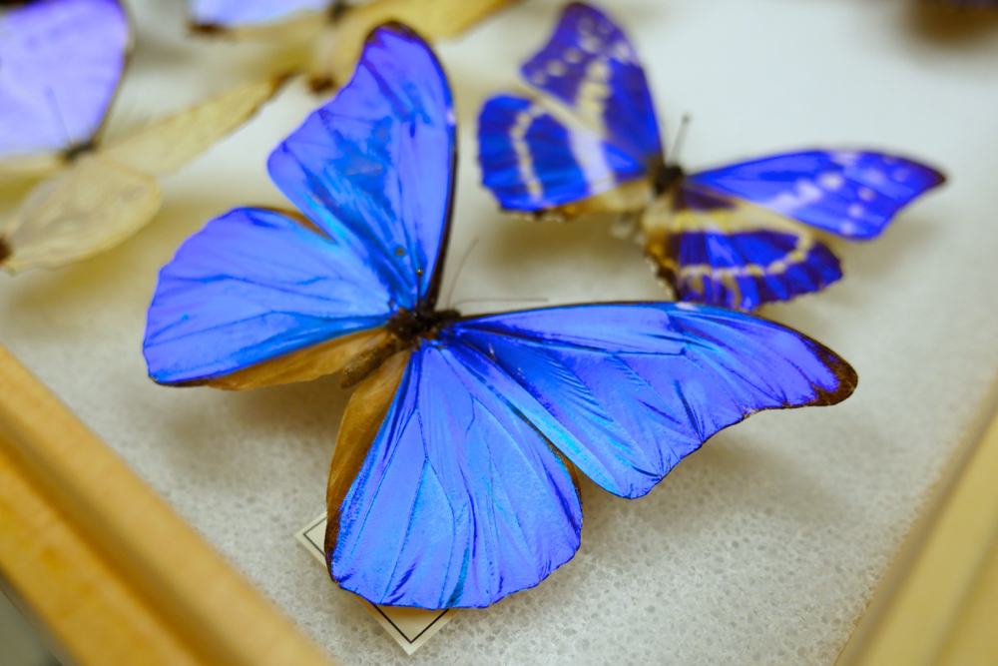

What is beauty (in physics)?
Before today:
Traditional beauty and its underlying mechanisms
Triumphs in molecular discovery and application
Artemisinin
https://www.kqed.org/science/24552/what-gives-the-morpho-butterfly-its-magnificent-blue
Knott, Doudna. (2018). Science. 361 (6405)
Tu. (2016). Angew. Chem. Int. Ed. 55
After today:
Abstracting complex phenomena into mathematical models
Better understanding of the world around us
Systematic approach to solving engineering problems

Slide 3


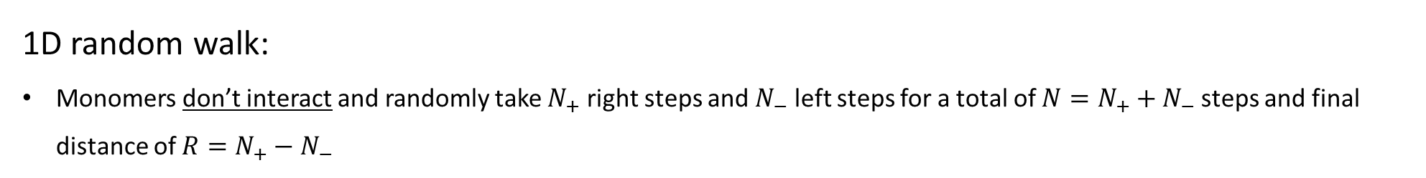

The (beautiful?) math of polymers
1D random walk:
Monomers don’t interact and randomly take $N_{+}$ right steps and $N_{−}$ left steps for a total of $N=N_{+}+N_{−}$ steps and final distance of $R=N_{+}−N_{−}$
2
5
6
1
0
3
4
7
$$R= 5 −2=3$$
Total number of trajectories (possible polymers) for a given $N$ and $R$:

Slide 4
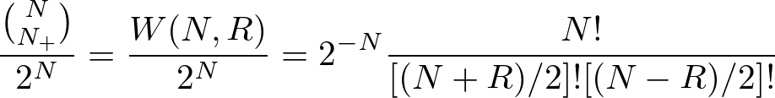
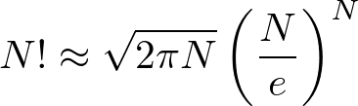
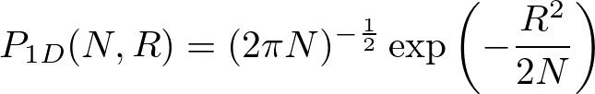
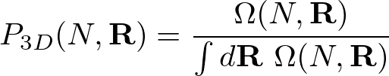

The (beautiful?) math of polymers
Probability
Total number of trajectories (possible polymers) for a given $N$ and $R$:
Algebra
Stirling’s formula:
Only non-zero $W(N,R)$’s (Divide by 2)
Entropy

Slide 5

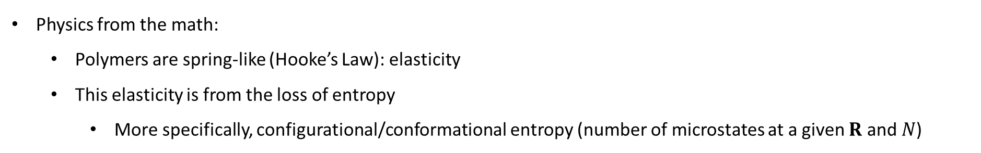
The (beautiful?) math of polymers
Entropy
Free Energy (Helmholtz)
(Monomers non-interacting)
Physics from the math:
Polymers are spring-like (Hooke’s Law): elasticity
This elasticity is from the loss of entropy
More specifically, configurational/conformational entropy (number of microstates at a given $R$ and $N$)
R
R
R
R
R
R
Elastic penalty

Slide 6
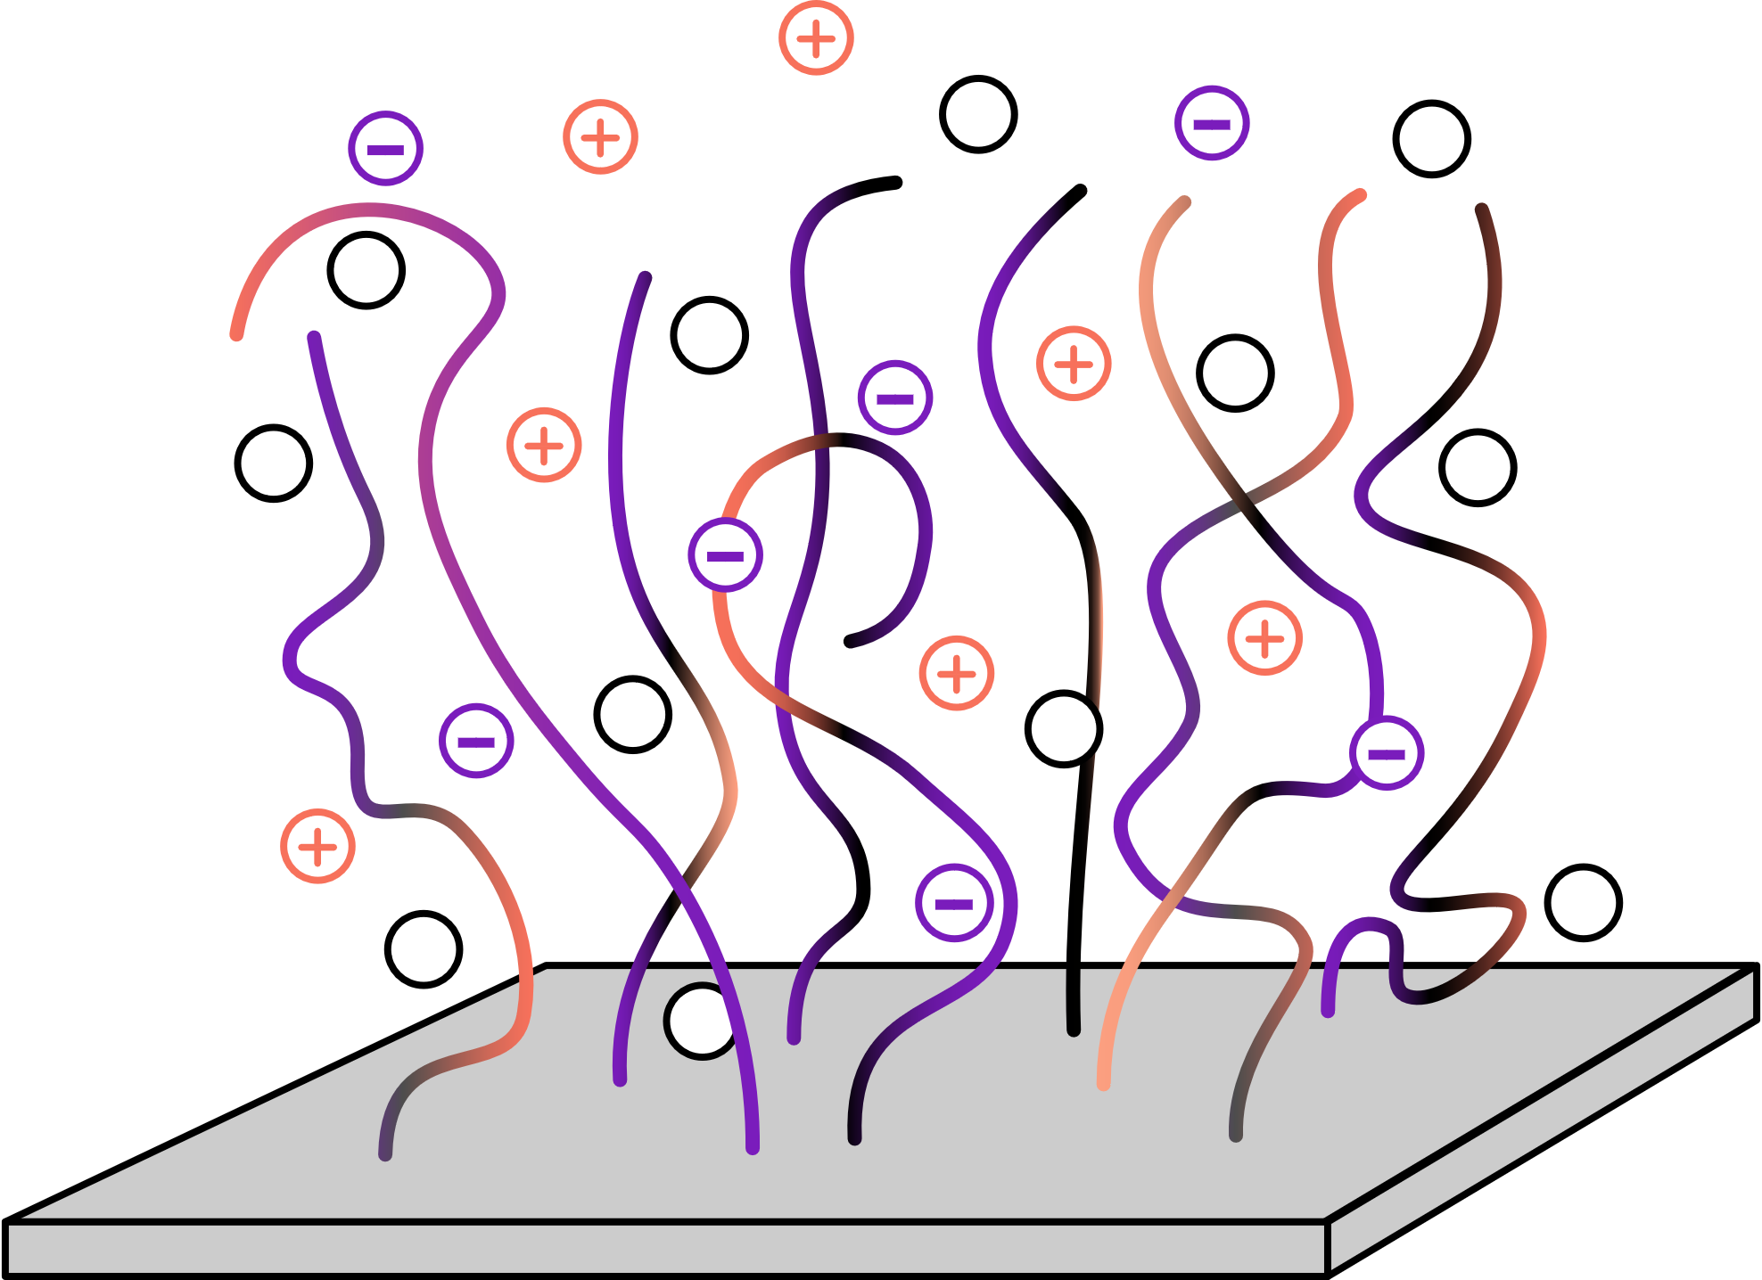
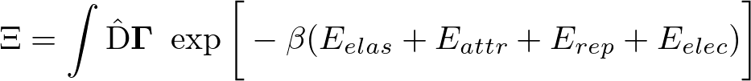
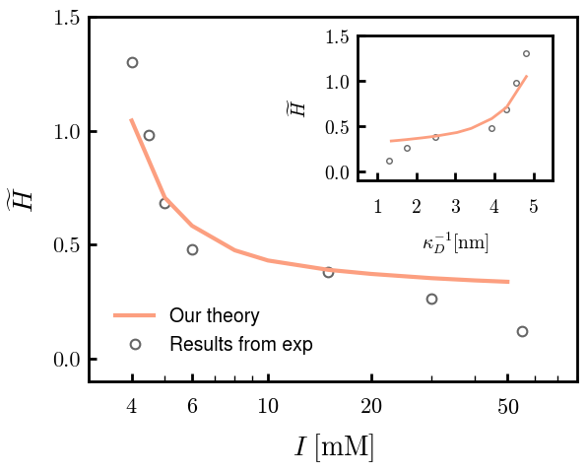
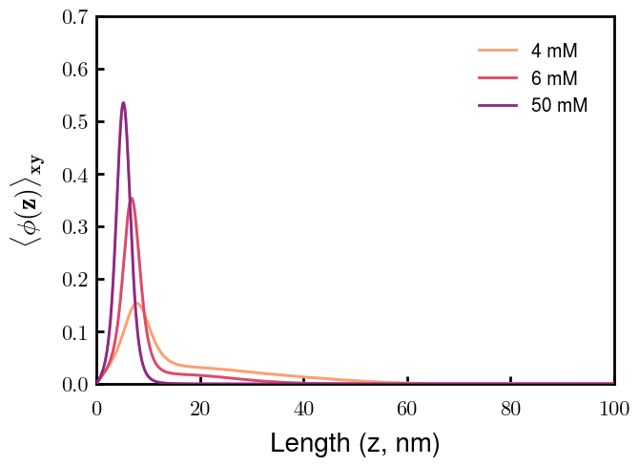
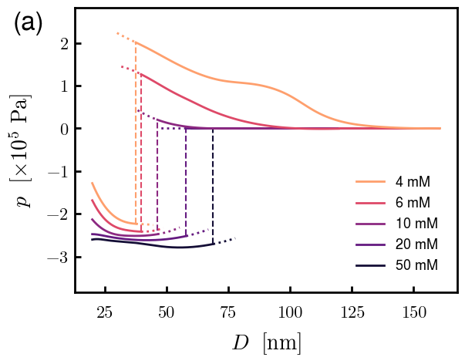

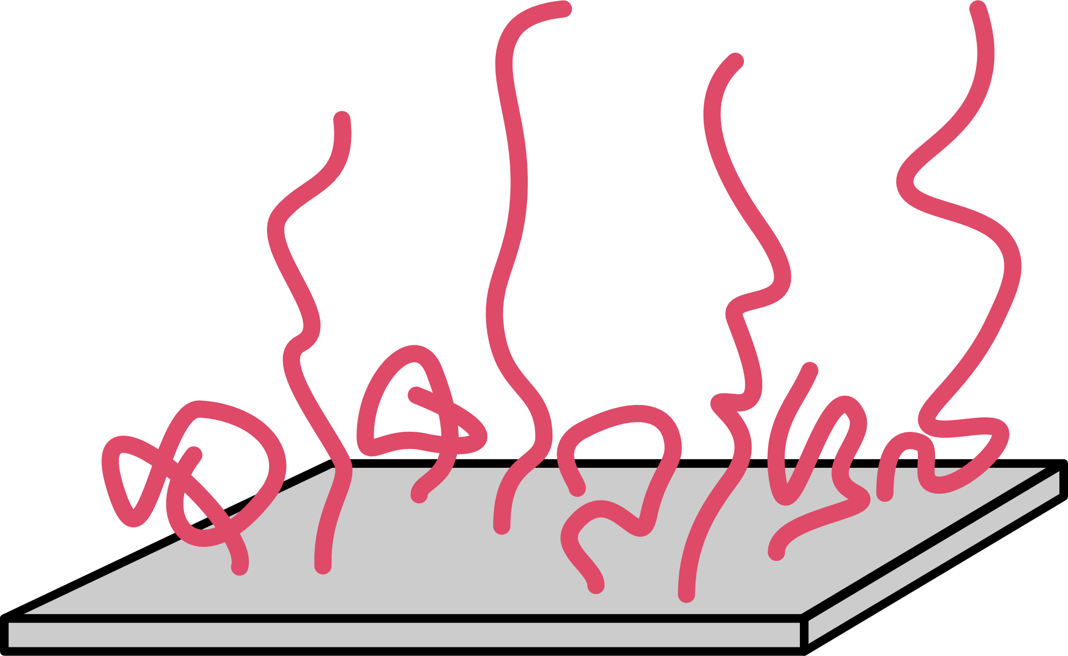
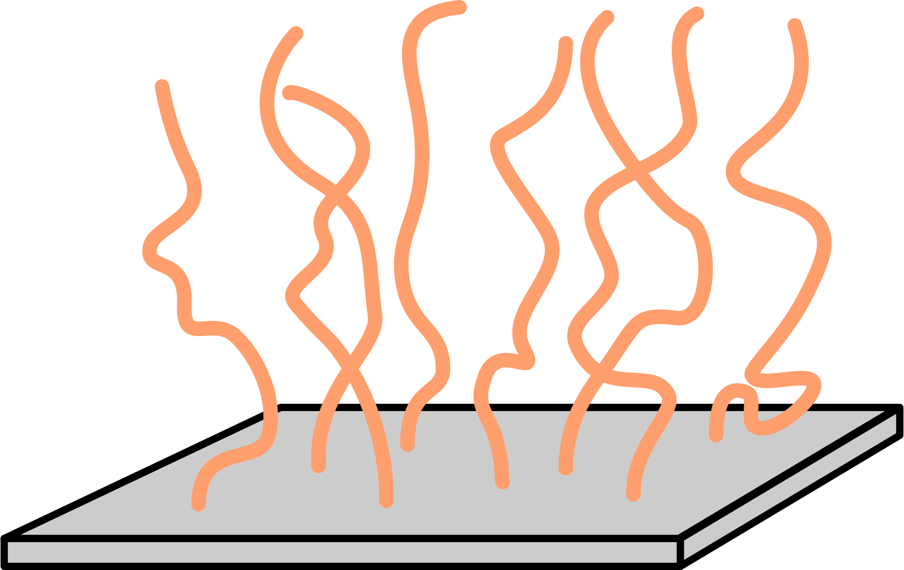
With a little more sophistication, theory can be a powerful, relevant tool
Gaussian chain
Flory-Huggins
Incompressibility
Electrostatics
Self-consistent field theory (SCFT)
Polymer morphologies (density profiles)
Phase transitions (free energies)
Much more!
Experimental comparison
Polymer organization
Spectra predictions
I
More importantly,

Slide 7
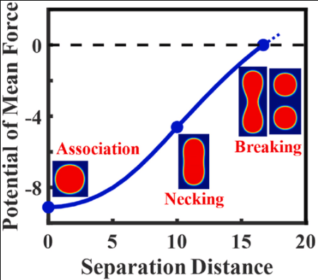
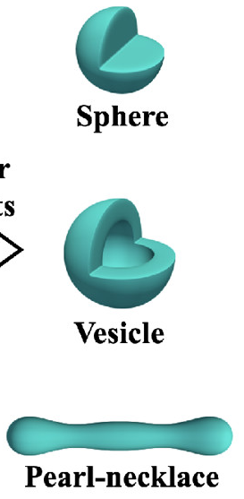
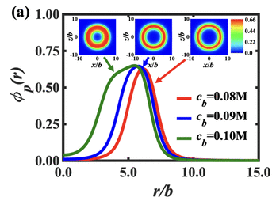
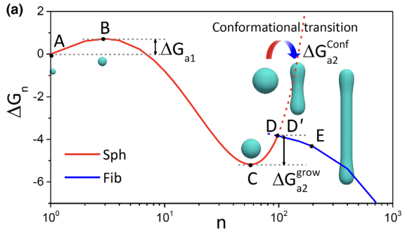
Other (beautiful?) applications of our theory
Mechanical response
Liu, Duan, Wang. (2022). Polymer. 258
Ionic response
Duan, Li, Wang. (2022). Macromolecules. 55 (3)
Aggregation kinetics
Duan, Li, Wang. (2022). Macromolecules. 55 (3)
Duan, Wang. (2023). Phys. Rev. Lett. 130

Slide 8
Thank you!

Slide 9
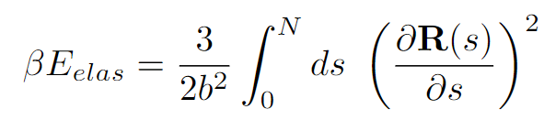
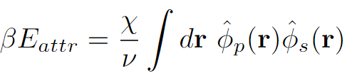
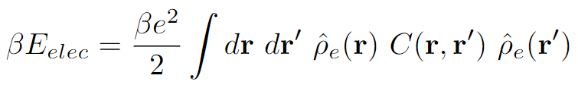

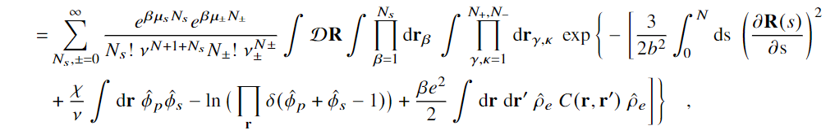
Partition Function Formulation
+
s
s
-
Elastic entropy following Gaussian statistics
+
-
+
s
s
Flory-Huggins short-range interactions
s
-
+
+
+
+
+
+
+
+
+
s
-
s
+
Electrostatic correlations
-
+
s
s
-
Local incompressibility
s
+
+
s

Slide 10

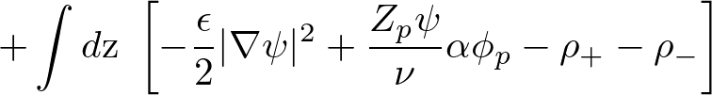

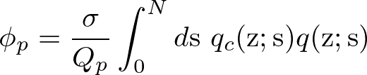
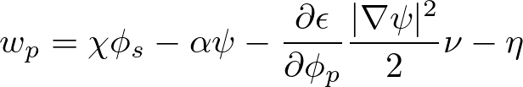
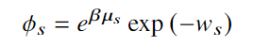


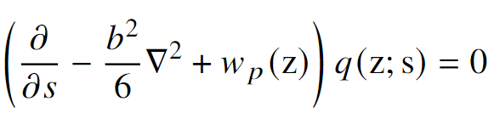
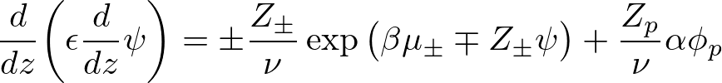



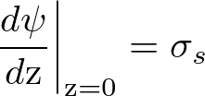

Free Energy and SCF Equations
Free Energy (ensemble average across surface)
Functional Minimization
Polymer Density:
Polymer-controlling Field:
Solvent Density:
Solvent-controlling Field:
Incompressibility:
Monomer Probability:
Electrostatic Potential:

